Slide 1


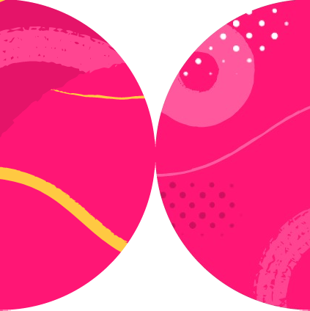

Configuring Playwright Tests

Slide 2
await btn.click({ clickCount: 5 });
test.use({
locale: 'en-US', headless: false,
// ...
});

Slide 3
export default defineConfig({
testDir: './tests', fullyParallel: true,
// ...
use: {
baseURL: 'http://localhost:3000', screenshot: 'only-on-failure',
// ...
},
// ...

Slide 4
Global Configuration
Group Configuration
Test Configuration

Slide 5

Overview
Test, Group and Global Configuration
Projects
Global setup and cleanup

Slide 6


Projects
Run all tests in chromium, firefox, webkit...
Run a subgroup of tests, e.g. smoke tests Point tests to Dev or Test environment

Slide 7
{
3x
test('Test', async ({ page }) => {
name: 'chromium', use: {
...devices['Desktop Chrome'] },
},
// ...
});
{
name: 'firefox', use: {
...devices['Desktop Firefox'] },
},
{
name: 'Mobile Safari', use: {
...devices['iPhone 12'] },
},

Slide 8
test('Test', async ({ page }) => {
{
name: 'Smoke',
testMatch: /.*smoke.spec.ts/
// ...
});
},
{
name: 'Mobile Tests’, testDir: './tests/mobile’
},

Slide 9
baseURL: 'dev.site.com',
},
{
test('Test', | async | ({ | page | }) | => | { | name: | 'dev-env',
 |  |  |  |  |  |  | use: | {
// ...
});
},
{
name: 'test-env’, use: {
baseURL: 'test.site.com',
},
},

Slide 10
test('Test', async () => {
const browser = await chromium.launch({ headless: false,
slowMo: 2000
});
// context level
const context = await browser.newContext({ baseURL: '...',
timezoneId: 'America/New_York', locale: 'es-ES',
// ...
});
});

Slide 11
test.use({
// + geolocation, viewport, baseURL, etc. actionTimeout: 3000,
navigationTimeout: 5000,
launchOptions: { slowMo: 2000, headless: true }
});

Slide 12
export default defineConfig({
// test suite level testDir: './tests',
fullyParallel: true, reporter: 'html',
use: {
// + geolocation, viewport, etc. baseURL: 'http://localhost:3000',
screenshot: 'only-on-failure', headless: false,
launchOptions: { slowMo: 2000 }
},
// ...

Slide 13
// by browser
{
name: 'firefox', use: {
...devices['Desktop Firefox’]
},
// by purpose
{
name: 'Smoke',
testMatch: /.*smoke.spec.ts/
},
// by environment
{
name: 'test-env’, use: {
baseURL: 'test.site.com',
},
}

Slide 14

Global Configuration
Group Configuration
More specific config wins in case of conflict
Test Configuration

Slide 15
locale: ‘en-US’
Global Configuration
Group Configuration
Test Configuration
locale: ‘es-ES’

Slide 16

Up Next:
Diving Deeper into Networking

